Slide 1

STREAMERS Climate Change: An analysis of temperature and carbon dioxide emissions trends and prediction for future trends in the World Data. Temitope Adeniyi Feven Belay Neca Bryan
T

Slide 2

OVERVIEW
This is an analysis of the Earth’s surface temperature and carbon dioxide data from 1990-2013 to determine the trends and predict future temperatures in the World data.

Slide 3


CONTENTS The areas of focus for this analysis will be
Technologies – Python, Jupyter Notebook, PostgresSQL, Tableau
SQL Database for creating tables and ascending data.
Machine Learning to predict variations from world average temp
a trend of temperature
predict whether dataset above or below the world mean temperatures
Analysis of Results

Slide 4


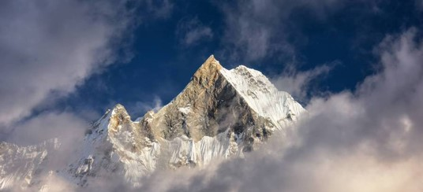
TECHNOLOGIES
The technologies utilized in this study were

Slide 5
PROCESS & RESULTS
Process
Add text, images, art, and videos.
Add transitions, animations, and motion.
Save to OneDrive, to get to your presentations from your computer, tablet, or phone.
Open the Design Ideas pane for instant slide makeovers.
When we have design ideas, we’ll show them to you right there.

Slide 6
DATABASES

Slide 7
PROCESS & RESULTS

Slide 8
Machine Learning
The Machine Learning model used to perform this analysis was Random Forest Model. This model was utilized because its a mix of classification and regression techniques to address imbalance data.

Slide 9
PROCESS
Read the csv file into our notebook
Large dataset – extract more current years using (.loc ) function for the years after 1900 ??
Cleaned data by w. (dropna, nunique, dtypes,) function
Renamed , formatted & reset index for some columns
Used (describe and transpose functions to access the data values (mean, std, etc.)
Transformed columns to numerical values (specific to ML use model only used numeric
Split the data into training & testing
Utilized a Random Forest Model
Fit the model
Calculated Accuracy Score
Generated Classification Report
Calculated Confusion Matrix

Slide 10
RESULTS
Accuracy Score – 71%.
Ratio of accuracy of the model. Based on the results the predictions are 71% correct.
Classification Report
F1 Score -
Confusion Matrix
Predicted 0 Predicted 1 Actual 0 25373 10778 Actual 1 13043 33002
Precision Recall F1 Score 0 0.66 0.70 0.68 1 0.75 0.72 0.73
Precision – reliability of the model when positive classifications are made
Recall – identify positive samples (sensitivity)
Confusion Matrix -

Slide 11
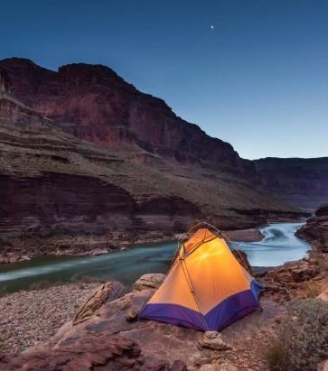


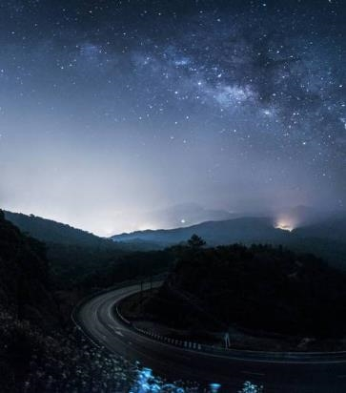
Summary
With PowerPoint, you can create presentations and share your work with others, wherever they are. Type the text you want here to get started. You can also add images, art, and videos on this template. Save to OneDrive and access your presentations from your computer, tablet, or phone.

Slide 12
RESOURCES
Berkeley Earth, affiliated Lawrence Berkeley National Laboratory .

